Slide 1
Gaussian Blur Different Parallel Platforms Comparison
Group No. 24
0756031 資工所 李鴻暘
0416324 資工系 胡安鳳
0416024 資工系 陳羿豐

Slide 2
Outline
What is Gaussian Blur.
Motivation and platform
Environment
Benchmark method
Different platforms explained and respective discoveries .
OpenMP
CUDA
OpenCL
Demo video.
Q&A

Slide 3


What is Gaussian Blur and why need?
An image processing algorithm using convolution to smooth images.
Can be used for noise reduction of the image.

Slide 4

Blurred effect vs filter size
5 x 5 filter
101 x 101 filter

Slide 5
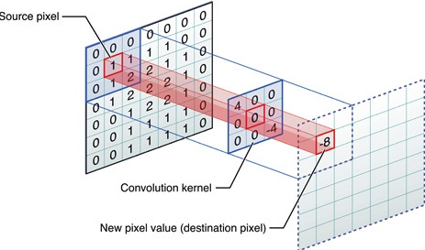
Motivation of this project
Widely used algorithm in lots of software like PhotoShop, GIMP.
Time complexity : O(img_width x img_height x filter_size^2)
huge!
Gaussian Convolution with its kernel
Img from Apple Dev.

Slide 6
Parallel Platforms
OpenMP
CUDA
OpenCL
CPU
CPU + GPU

Slide 7
How we parallel
Pthread/OpenMP
CUDA/OpenCL

Slide 8
Environment for this project
CPU | Intel i5 7500 (4C 4T)
GPU | NVIDIA GTX1070 (1920 CUDA Cores)
SSD | Samsung PM981 SSD 512GB
RAM | DDR4 2666 8G x 4
OS | Ubuntu 16.04 64bit

Slide 9

Benchmark method
8K(7680 x 4320) image for processing
Filter size fixed to 101 x 101
Computation is 338444697600 (338 billion!)
Check error percent if needed (diff image)
Baseline
Serial time is 82m44s (4964s)

Slide 10
OpenMP

Slide 11
Using OpenMP
We only need to add some #pragma lines to our program to parallelize it. OpenMP is convenient.
Parallelization method: Segment the image into 4 part, each part for one thread respectively. (OpenMP default)

Slide 12
Try to Speed Up
#pragma omp parallel for schedule(static, 1)
Each part would be 1 pixel high
No difference in performance

Slide 13

OpenMP result
Serial 4964sec, OpenMP 1332sec, accelerate 3.73x
Error is 0% by using diff.

Slide 14
CUDA

Slide 15
1024 threads per block
4320
Total 32400*3 blocks
7680

Slide 16

Result
Serial 4964sec, CUDA 5.875sec, accelerate 857x
Error is 1% but unseen by eye in blurred image.

Slide 17
Threads per block vs performance
Secs
Threads per block

Slide 18
Result
Serial 4964sec, OpenCL 5.532sec, accelerate 897x
Error is 1% but unseen by eye in blurred image.

Slide 19

CAN WE DO FASTER?

Slide 20
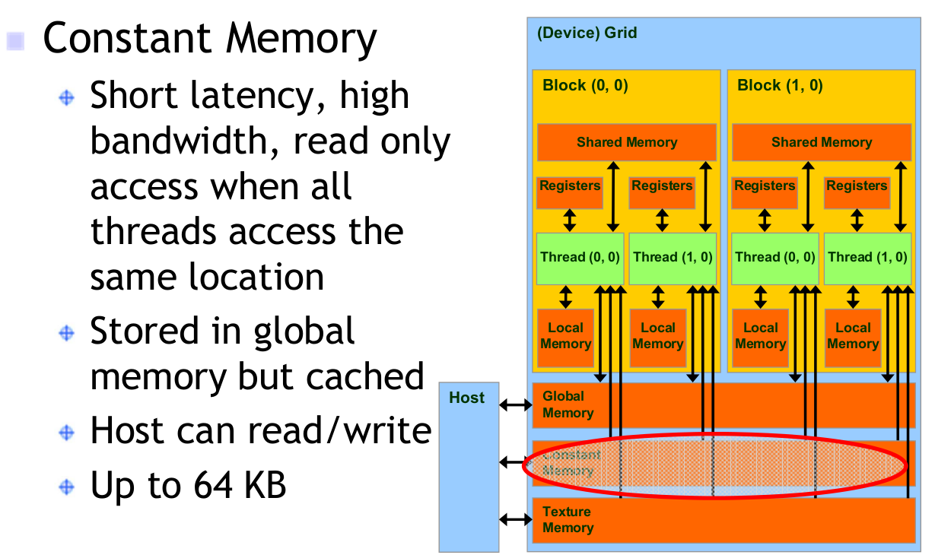
Do faster with Constant Memory
Filter is frequently and repeatedly accessed but GPU global memory is quite slow.

Slide 21
Threads per block vs const performance
32%
Secs
14%
14%
22%
27%
Threads per block

Slide 22
Result with const memory
CUDA const 4.48sec, accelerate 1108x
Identical with normal CUDA, error 1 %

Slide 23
OpenCL

Slide 24
250 thread per block
1024 threads per block
4320
Total 129600*3 threads
7680

Slide 25
Pros & Cons
Pros
Don’t need to concern with GRID SIZE & BLOCK SIZE
256 threads per block
252 threads per block
2268
4320
4032
7680

Slide 26
Pros & Cons
Pros
Don’t need to concern with GRID SIZE & BLOCK SIZE
Maybe Faster?

Slide 27

Pros & Cons
Pros
Don’t need to concern with GRID SIZE & BLOCK SIZE
Maybe Faster?
Cons
Initialization is a NIGHTMARE!

Slide 28


Slide 29
Individual Works
名字 | 負責
胡安鳳 | CUDA、PPT、Demo Video Editing、Environment Support
李鴻暘 | OpenCL、PPT
陳羿豐 | OpenMP、Code Suggestions

Slide 30

Q&A

